Slide 1
Rethinking AIG Resynthesis in Parallel
DAC 2023
Presented by: 賈俊佑

Slide 2
Outline
Introduction
Preliminaries
Method
GPU-Parallel Refactoring
GPU-Parallel Balancing
Experimental Results
Conclusion

Slide 3
Introduction
AIG is widely used in logic optimization
AIG resynthesis combines multiple optimization algorithms in a sequence
- resyn2: b; rw; rf; b; rw; rwz; b; rfz; rwz; b
b = balancing
rw = rewriting
rf = refactoring
z = zero-gain
: reduce AIG level / delay
: replace small local subgraphs
: resynthesize larger logic cones
: allow non-worse replacement
resyn2 repeatedly applies balancing, rewriting, and refactoring

Slide 4
Motivation
Large AIGs make resyn2 time-consuming
Previous work has accelerated rewriting on GPUs
but resyn2 also includes refactoring and balancing
This paper parallelizes refactoring and balancing on GPUs
enabling a full GPU-accelerated resyn2 flow

Slide 5
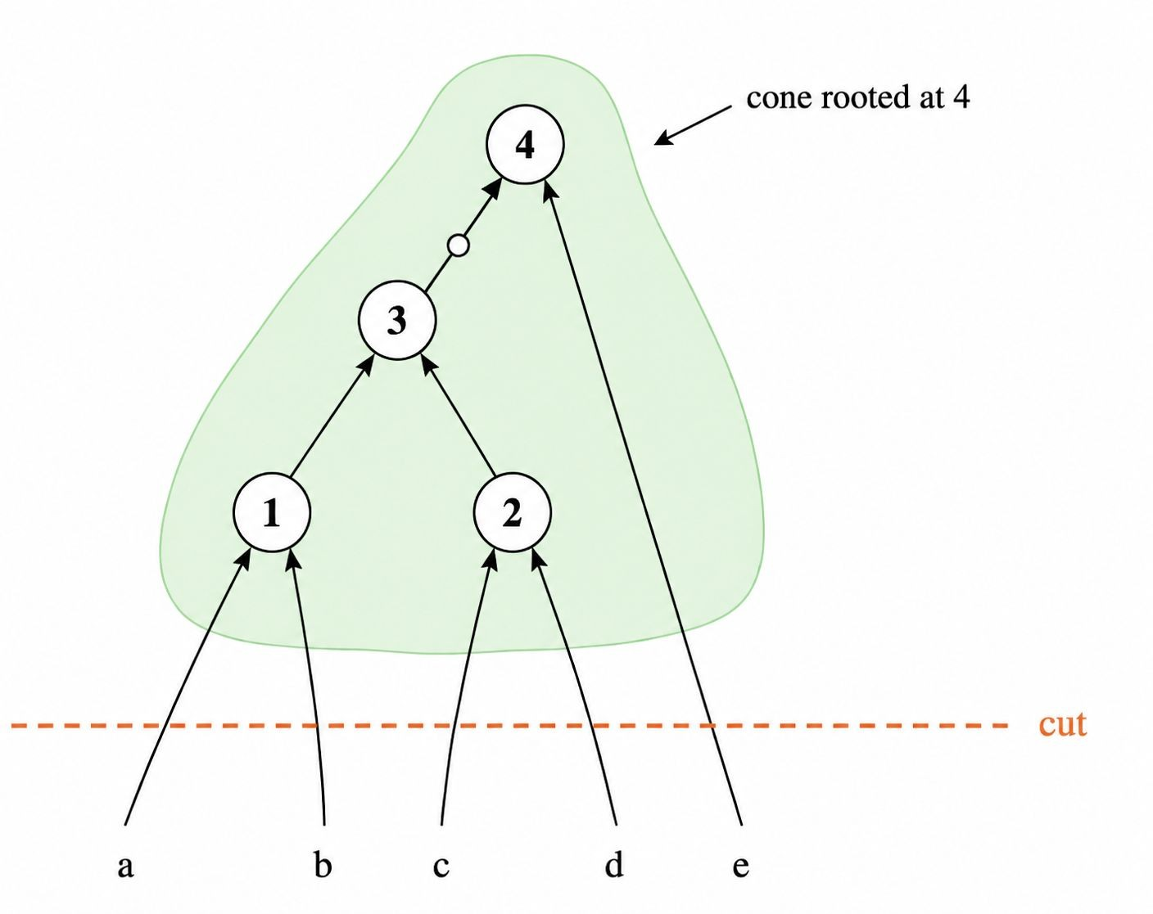
Preliminaries - AIG and Cone
AIG
internal nodes are 2-input AND gates
edges may be complemented
Metrics
area = number of AIG nodes
delay = number of AIG levels
Cone
local subgraph rooted at a node
cut nodes are the inputs of the cone

Slide 6
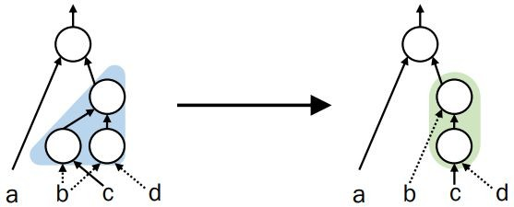
Background - AIG Refactoring
Refactoring optimizes larger local logic cones
Cone selection
identify a local logic cone
Resynthesis
rebuild an equivalent cone
Replacement
replace the original cone if quality improves

Slide 7
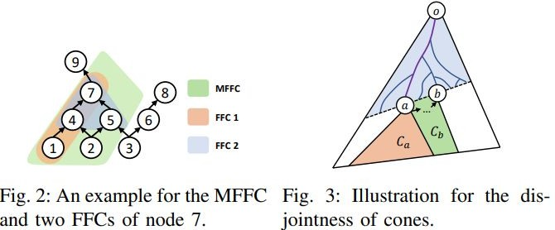
Fanout-Free Cone and MFFC
Fanout-Free Cone (FFC)
internal nodes are not shared with outside logic
Maximum Fanout-Free Cone (MFFC)
largest FFC of a root
Why FFC is useful
replacing an FFC does not affect logic outside the cone
disjoint FFCs can be processed independently

Slide 8
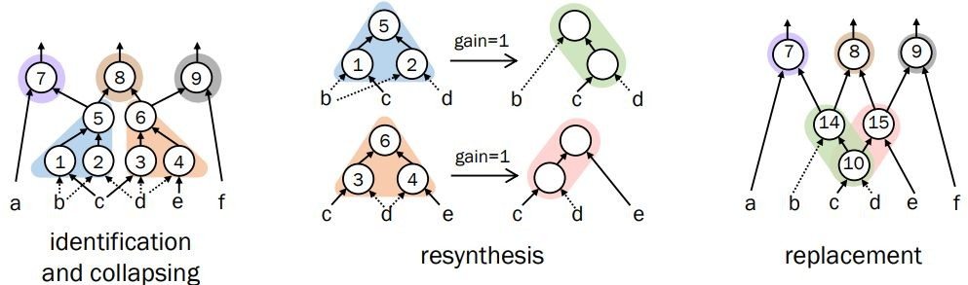
GPU-Parallel Refactoring
Basic idea
- use disjoint FFCs as independent optimization units
Three-stage flow
Identify and collapse disjoint FFCs
Resynthesize collapsed FFCs in parallel
Replace positive-gain cones in parallel

Slide 9
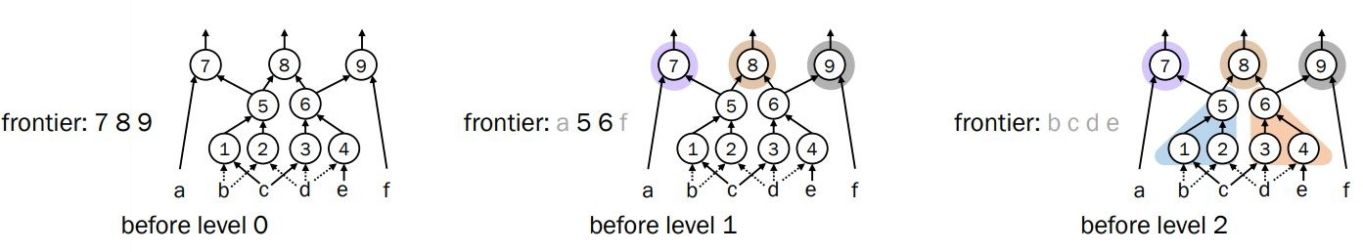
Stage 1: Identify and Collapse Disjoint FFCs
Frontier = current roots to be processed
Start from primary outputs
For each node in the frontier:
find its fanout-free cone
collapse the cone into a local Boolean function
Cone inputs become the next frontier
Repeat from POs to PIs

Slide 10
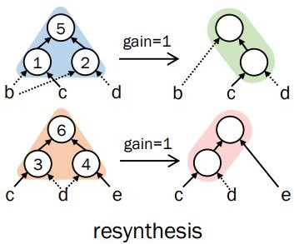
Stage 2: Parallel Resynthesis
Resynthesize collapsed FFCs in parallel
Compute gain after resynthesis
Keep positive-gain cones for replacement

Slide 11
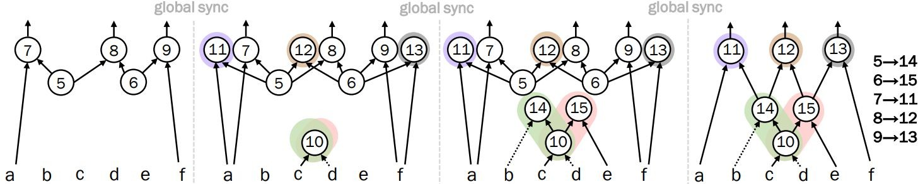
Stage 3: Parallel Replacement
Insert new nodes synchronously in parallel
one thread per cone
global synchronization between insertion steps
Replace old cone roots with new roots

Slide 12
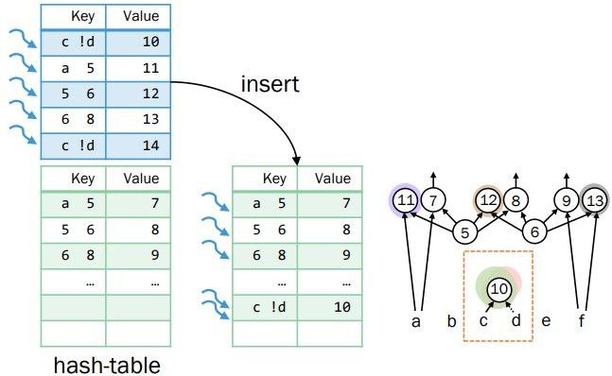
GPU-Parallel Hash-table
Structural hashing
use fanins and inversion status as keys
avoid duplicated nodes and enable logic sharing
Insertion issue
the same key may be inserted more than once
GPU hash-table solution
supporting batched node insertion and retrieval

Slide 13
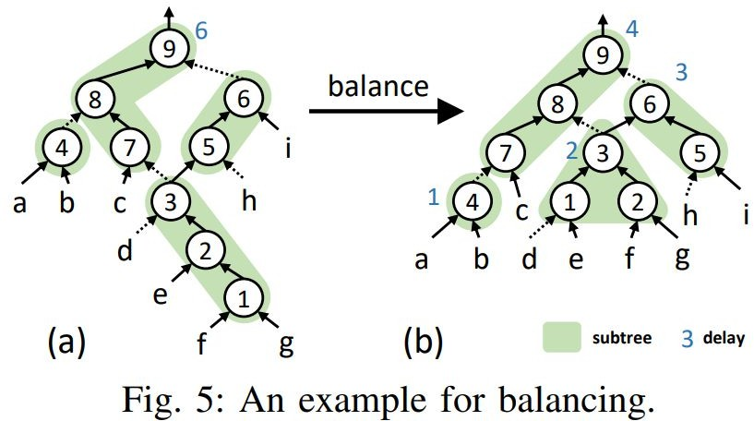
Background - AIG Balancing
Balancing reduces AIG level / delay
Collapse
identify n-input AND-tree structures
e.g., node 3 → AND(d,e,f,g)
Recursive balancing
balance cut nodes and obtain their delays
Reconstruction
rebuild the AND-tree in ascending delay order

Slide 14
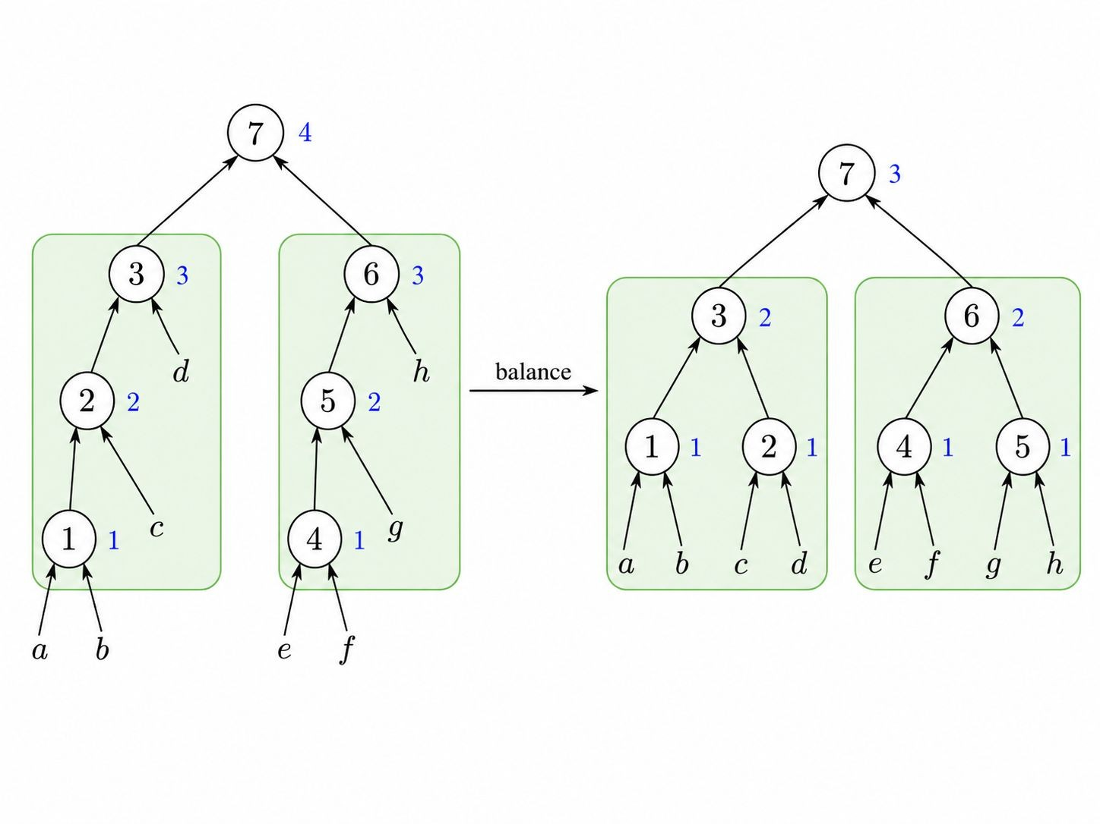
GPU-Parallel Balancing
Stage 1: Collapse
identify n-input AND subtrees
process level by level from POs to PIs
store collapsed subtrees for reconstruction
Stage 2: Reconstruction
rebuild collapsed AND subtrees
process level by level from PIs to POs
reconstruct same-level AND subtrees in parallel

Slide 15
Experimental Setup
Baseline:
original ABC sequential resyn2 flow
Benchmarks:
enlarged EPFL combinational benchmark suite
enlarged control circuits from the IWLS 2005 benchmark suite
Evaluation metrics:
runtime speedup
AIG area: number of nodes
AIG delay: number of levels

Slide 16
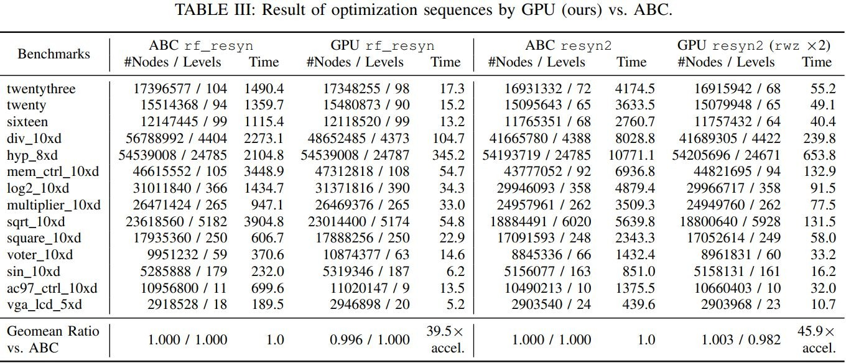
Experimental Results - Speedup and QoR

Slide 17
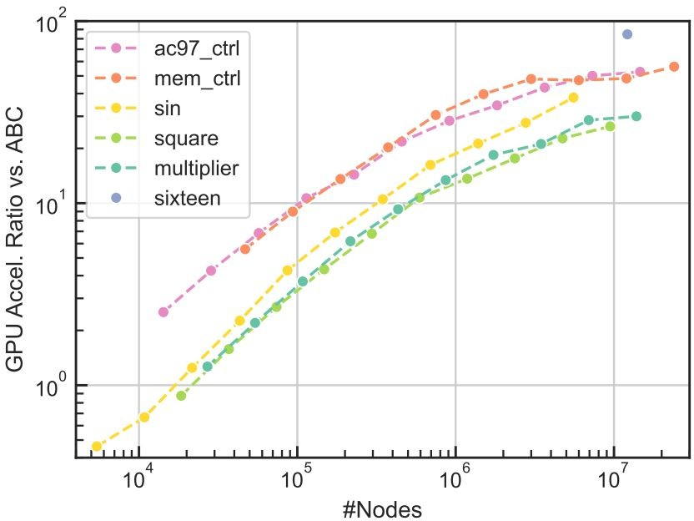
Experimental Results - Scalability
Speedup increases as AIG size grows
GPU acceleration becomes effective for AIGs with more than 30K nodes

Slide 18
Conclusion
Proposed GPU-parallel algorithms for AIG refactoring and balancing
Integrated with GPU rewriting to accelerate the full resyn2 flow
Full GPU resyn2 achieves:
45.9× speedup over ABC resyn2
comparable QoR

